Slide 1


Hypothesis Testing
Hypothesis testing is a statistical method that is used in making a statistical decision using experimental data.
Hypothesis testing evaluates two mutually exclusive population statements to determine which statement is most supported by sample data.
Notes:
Maggie noodles were banned on the claim that there is excess amount of lead in it. Govt. regulatory body says that there cannot be more than 2.5ppm lead content. We cannot survey 1 million packets.
They did a survey on 10,000 products.

Slide 2
Parameters of hypothesis testing
Null hypothesis(H0): It is a basic assumption based on the problem knowledge.
Alternative hypothesis(H1): The alternative hypothesis is the hypothesis used in hypothesis testing that is contrary to the null hypothesis.
Null Hypothesis : A company production is equal to 50 unit/per day
Alternate Hypothesis: : A company production is not equal to 50 unit/per day
H0 : amount of lead in Maggie noodles does not exceed the maximum limit i.e., 2.5ppm
H1: amount of lead in Maggie noodles exceed the maximum limit i.e., 2.5ppm

Slide 3
Outcome 1: We reject the null hypothesis when in reality it is false.
Outcome 2: We reject the null hypothesis when in reality it is true.
(Type 1 Error)
Outcome 3: We failed to reject the null hypothesis when in reality it is false.
(Type 2 Error)
Outcome 4: We failed to reject the null hypothesis when in reality it is true.
We say “We failed to reject the null hypothesis” instead of “we accept the null hypothesis”.
Notes:
Australian Tree Lobsters were assumed to be extinct. There was no evidence that any were still living because no one had seen them for decades.
Lack of proof doesn’t represent proof that something doesn’t exist!.

Slide 4
P-value The P value is the probability for the null hypothesis to be true.
Level of significance The level of significance is the probability of rejecting the null hypothesis when it is true.
If the p-value is less than α, then the null hypothesis is rejected, and the alternative hypothesis is accepted. If the p-value is greater than α, then the null hypothesis is not rejected.
Notes:
A school claimed that the students’ studying there have an average IQ 100.
P- value is the probability for the null hypothesis to be true.
How likely it is to draw a sample in which

Slide 5
Z - Test
When to Use Z-test:
Samples should be drawn at random from the population.
The sample size should be greater than 30.
The standard deviation of the population should be known.

Slide 6

Steps to perform Z-test:
First, identify the null and alternate hypotheses.
Determine the level of significance (∝).
Calculate the z-test statistics. Below is the formula for calculating the z-test statistics.
where,
$\overline{X}$: mean of the sample.
$μ$: mean of the population.
$σ$: Standard deviation of the population.
n: sample size.

Slide 7
Find p value using z statistics.
Now compare with the hypothesis and decide whether to reject or not to reject the null hypothesis

Slide 8
Suppose the arousal of hot cats has a population that is normally distributed with a standard deviation of 6. Tomorrow you sample 49 hot cats from this population and obtain a mean arousal of 46.44 and a standard deviation of 5.6968. Using an alpha value of α = 0.01, is this observed mean significantly less than an expected arousal of 47?

Slide 9
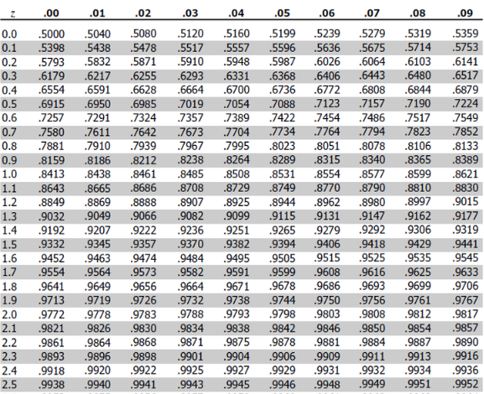

Slide 10
Problem: A school claimed that the student’s study is more intelligent than the average school. On calculating the IQ scores of 50 students, the average turns out to be 110. The mean of the population IQ is 100 and the standard deviation is 15. State whether the claim of principal is right or not at a 5% significance level.

Slide 11
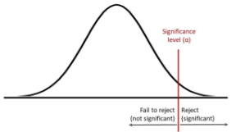

Slide 12
A teacher claims that the mean score of students in his class is greater than 82 with a standard deviation of 20. If a sample of 81 students was selected with a mean score of 90 then check if there is enough evidence to support this claim at a 0.05 significance level.

Slide 13
Suppose the width of makeshift personalities has a population that is normally distributed with a standard deviation of 7. You want to sample 22 makeshift personalities from this population and obtain a mean width of 87.19 and a standard deviation of 7.257. Using an alpha value of α = 0.01, is this observed mean significantly less than an expected width of 89?

Slide 14
Z – Test (two – tailed)

Slide 15
Suppose the jewelry of exams has a population that is normally distributed with a standard deviation of 5. You are walking down the street and sample 9 exams from this population and obtain a mean jewelry of 28.95 and a standard deviation of 6.3802. Using an alpha value of α = 0.01, is this observed mean significantly different than an expected jewelry of 27?

Slide 17
Suppose the life expectancy of Seattleites has a population that is normally distributed with a standard deviation of 1. You go out and sample 45 Seattleites from this population and obtain a mean life expectancy of 88.51 and a standard deviation of 1.0815. Using an alpha value of α = 0.05, is this observed mean significantly different than an expected life expectancy of 89?

Slide 18
Suppose the width of bus riders has a population that is normally distributed with a standard deviation of 10. Suppose that before graduation, your first job was to sample 98 bus riders from this population and obtain a mean width of 49.98 and a standard deviation of 10.3386. Using an alpha value of α = 0.01, is this observed mean significantly different than an expected width of 52?

Slide 19
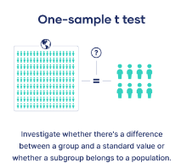
T - Test
A t-test is a statistical test that compares the means of two samples. It is used in hypothesis testing, with a null hypothesis that the difference in group means is zero and an alternate hypothesis that the difference in group means is different from zero.
Notes:
T test checks whether the subgroup with mean 73 belongs to the population having mean 75.

Slide 20
There are three main types of t-test:
A One sample t-test tests the mean of a single group against a known mean.
An Independent Samples t-test compares the means for two groups.
A Paired sample t-test compares means from the same group at different times (say, one year apart).
Notes:
One-tailed or two-tailed t test?
If you only care whether the two populations are different from one another, perform a two-tailed t test.
If you want to know whether one population mean is greater than or less than the other, perform a one-tailed t test.

Slide 21
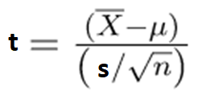
Steps to perform T-test:
First, identify the null and alternate hypotheses.
Determine the level of significance (∝).
Calculate the degree of freedom df = n-1
Find the critical value of t in the t-test using t- table.
Calculate the t-test statistics. Below is the formula for calculating the t-test statistics.
where,
$\overline{X}$: mean of the sample.
$μ$: mean of the population.
$s$: Standard deviation of the sample.
n: sample size.
Now compare with the hypothesis and decide whether to reject or not to reject the null hypothesis
Notes:
One-tailed or two-tailed t test?
If you only care whether the two populations are different from one another, perform a two-tailed t test.
If you want to know whether one population mean is greater than or less than the other, perform a one-tailed t test.

Slide 22
Problem: A school claimed that the students’ study that is more intelligent than the average school. On calculating the IQ scores of 30 students, the average turns out to be 140 and standard deviation is 20. The mean of the population IQ is 100 . State whether the claim of principal is right or not at a 5% significance level.

Slide 23
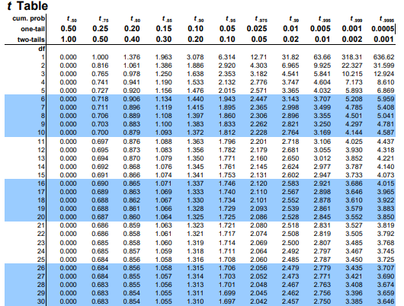

Slide 24
Suppose we are interested in determining whether the average weight of a certain breed of dog is significantly different from a target weight of 25 pounds. We randomly select a sample of 20 dogs from this breed and weigh them and get the mean 24 pounds and standard deviation is 0.7. State whether the claim we made is right or not at a 5% significance level.

Slide 25
There are three main types of t-test:
A One sample t-test tests the mean of a single group against a known mean.
An Independent Samples t-test compares the means for two groups.
A Paired sample t-test compares means from the same group at different times (say, one year apart).
Notes:
One-tailed or two-tailed t test?
If you only care whether the two populations are different from one another, perform a two-tailed t test.
If you want to know whether one population mean is greater than or less than the other, perform a one-tailed t test.

Slide 26
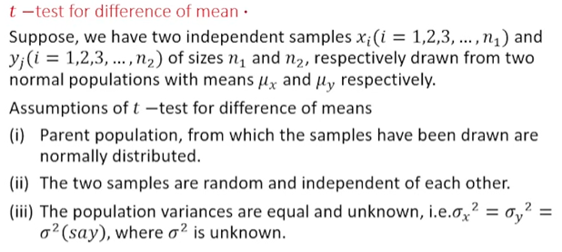

Slide 27
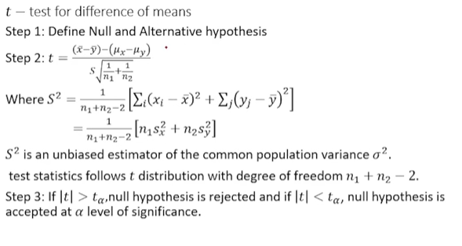

Slide 28
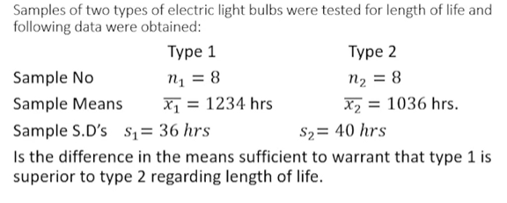

Slide 29
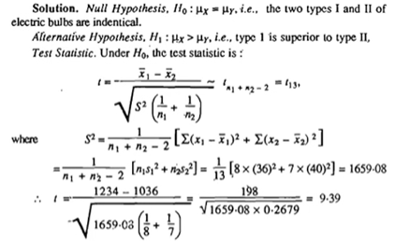
Notes:
Tc = 1.77, since, t statistics> tc null hypothesis is rejected.

Slide 30
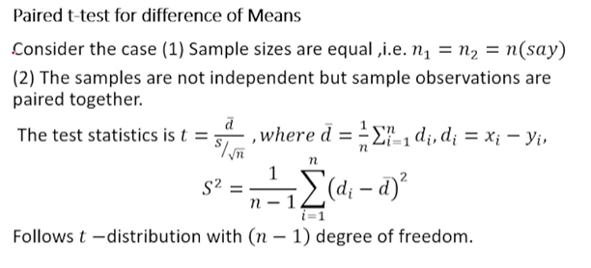

Slide 31
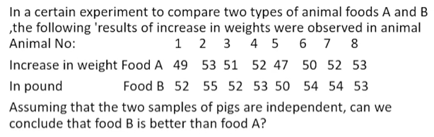
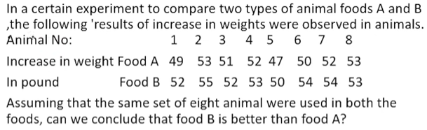
Practice Questions
Q1
Q2

Slide 32
Chi- Square Test
It is a powerful test for testing the significance of the discrepancy between theory and experiment.
(OR)
The Chi-square (χ2 ) test represents a useful method of comparing experimentally obtained results with those to be expected theoretically on some hypothesis.
Notes:
It is very obvious that the importance of such a measure would be very great in sampling studies where we have invariably to study the divergence between theory and fact.

Slide 33
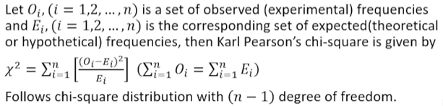
Notes:
Suppose we are given a set of observed frequencies obtained under some experiment and we want to test if the experimental results support a particular hypothesis or theory.

Slide 34
The value of chi-square is very big it indicates that the divergence between expected and observed frequencies is large.
If the value of chi-square is very small it indicates that the divergence between actual and expected frequencies is very little.
Notes:
Suppose we are given a set of observed frequencies obtained under some experiment and we want to test if the experimental results support a particular hypothesis or theory.

Slide 35
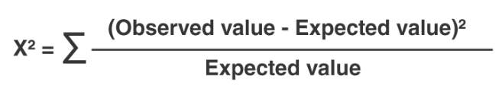
The following steps are followed for the above said purpose:
A null and alternative hypothesis related to the enquiry
expected or theoretical frequencies are derived through probability.
iii. A level of significance is chosen for rejection of the null hypothesis.
iv. Chi Square value
v. The observed frequencies are compared with the expected or theoretical frequencies.
If the calculated value of $χ^{2}$ is less than the table value, failed to reject the null hypothesis. On the other hand, if the calculated value of $χ^{2}$ is greater than the table value, we will reject the null hypothesis.

Slide 36
Problem Ninety-six subjects are asked to express their attitude towards the proposition “Should AIDS education be integrated in the curriculum of Higher secondary stage” by marking F (favorable), I (indifferent) or U (unfavorable).
Test the hypothesis that “there is no difference between preferences in the group”.
Observed(fo) | 48 | 24 | 24
Expected (fe) | 32 | 32 | 32

Slide 37
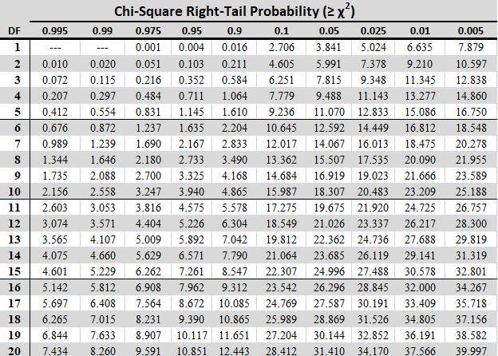

Slide 38
Two hundred bolts were selected at random from the output of each of the five machines. The number of defective bolts found were 5, 9, 13, 7 and 6 . Is there a significant difference among the machines? Use 5% level of significance.

Slide 39
Chi- Square Test for feature selection
Feature selection is selecting best and optimal features for Machine learning model.
In this we remove irrelevant or partially relevant features from the data.
Minimizes the cost of computation.
Reduces the curse of dimensionality
Helps in achieving good accuracy.
Notes:
One of the primary tasks involved in any supervised Machine Learning venture is to select the best features from the given dataset to obtain the best results. One way to select these features is the Chi-Square Test.
We have data in which we have columns name address race religion attendance marks.

Slide 40
Chi-square Test for Feature Extraction:
We calculate Chi-square between each feature and the target and select the desired number of features with best Chi-square scores.
The higher the value of $χ^{2}$, the more dependent the output label is on the feature and higher the importance the feature has on determining the output.
It determines if the association between two categorical variables of the sample would reflect their real association in the population.
Notes:
A Chi-Square test is done on two distributions to determine the level of similarity of their respective variances. In its null hypothesis, it assumes that the given distributions are independent. This test thus can be used to determine the best features for a given dataset by determining the features on which the output class label is most dependent on. For each feature in the dataset, the $χ^{2}$ is calculated and then ordered in descending order according to the $χ^{2}$ value.

Slide 41
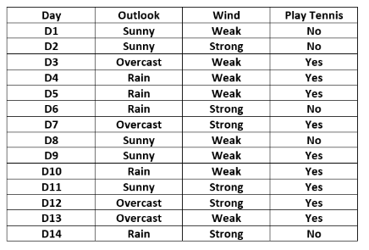
Consider the following table:-

Slide 42
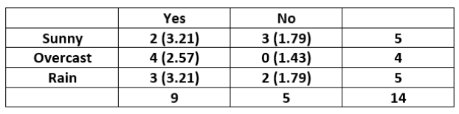
The contingency table for the feature “Outlook” is constructed as below:-

Slide 43
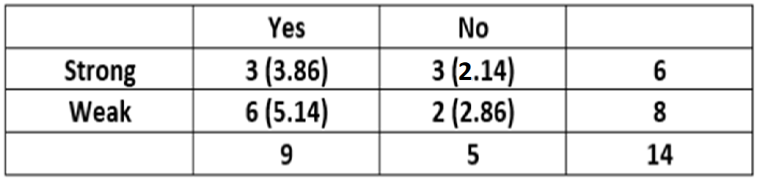
The contingency table for the feature “Wind” is constructed as below:-

Slide 44

Thank you

